Slide 1
Section 3.4
Applications of Percentages
© Copyright all rights reserved to Homework depot: www.BCMath.ca

Slide 2
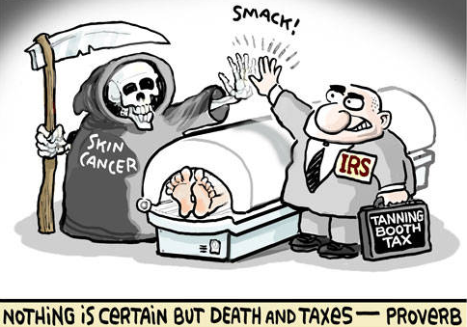
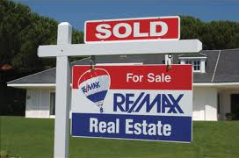



Applications
Percentages is often used in areas where money is involved
Taxes to the government [GST, PST, Income Tax]
  You pay taxes based on a percentage of your income
Commission: money earned from sales
  You get paid based on a percentage of what you sell
Discounts from a sale: Money reduced from the regular price
Appreciation/Depreciation: Growth or decrease in the value of an object
  Cars usually depreciates in value each year
  Houses usually increase in value each year
© Copyright all rights reserved to Homework depot: www.BCMath.ca

Slide 3
Ex: Micheal is a realtor for Remax and he earns 3% commission on the first $100,000 and then 1% on the rest of the estate. How much will he earn if he sold a house for $850,000?
The house is worth $850,000, so he earns 3% of $100,000 and 1% on
rest of the house ($750,000)
First $100,000
Rest of Cost:
The total commission earned will be:
© Copyright all rights reserved to Homework depot: www.BCMath.ca

Slide 4
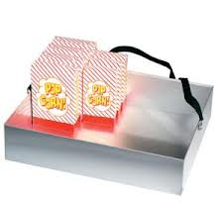
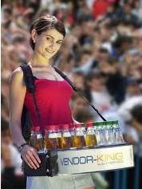
Practice: Tom works at the PNE as a vendor and makes $5 each hour and 20% commission on all his sales. How much will he make in one day if he worked for 8 hours and made $950 in sale?
There’s two parts to this question because is he paid in two different
ways: commission and salary
His salary for eight hours of work will be:
His commission is 20% of all his sales
The total amount of money he made in one day of work is:
© Copyright all rights reserved to Homework depot: www.BCMath.ca

Slide 5

Ex: Alan went to the Apple store to buy an iPad for $500. It was on sale at 20% off because he had a friend who worked there. If tax is 12%, how much will he pay in total?
20% of the cost is taken off the regular price of $500.00
Discount:
Sale Price:
= Original Price – Discount
Tax is 12% on the
sale price of the iPad
Tax:
= Sale Price x 12%
Total
Cost:
= Sale Price + Tax
© Copyright all rights reserved to Homework depot: www.BCMath.ca

Slide 6

Practice: Jenny went to Starbucks and bought 4 cups of coffee at $3.25 each. If tax is 12%, how much would the total be?
First calculate the total cost of the four cups of coffee before tax
Now calculate the tax on the coffees
Total cost = Cost before Tax + Tax
© Copyright all rights reserved to Homework depot: www.BCMath.ca

Slide 7

Ex: Johnny went to Sportscheck to buy a snowboard at a price of $450. Last week the snowboard was on sale at 50% off. This weekend, the snowboard will be on another sale at 50% off. How much will the snowboard be after the second sale?
Q: Is the snowboard free?
Ie: 50% + 50% off is 100% off???
NO!!
Under the first sale, the price
dropped by 50%, so it costs $225
Under the second sale, the price
dropped by 50% again.
However this time it is only 50% of $225. So the price will be
half of $225, which is

Slide 8
Ex: Johnny went to Sportscheck to buy a snowboard at a price of $450. Last week the snowboard was on sale at 40% off. This weekend, the snowboard will be on another sale at 60% off. How much will the snowboard be after the second sale?
Q: Will this sale be cheaper than
the previous one or the same??
Let’s find out!
1st discount is 40% off. So you
keep 60% of the price
2nd Discount is 60% off, so you keep 40% of the price
The sale price after both discount is $108

Slide 9
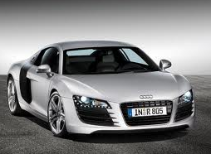
Challenge: Jerry bought an Audi R8 for $80,000. If the value of the vehicle depreciates 10% each year, what would be the value after 4 years?
Depreciation means that the value of the car
will go down
Keep in mind that: If you lose 10%, that means you keep 90%
If you lose 10% each year, think of it as keeping only 90% each year
So multiply by 0.90 for each year that the car depreciates
1st year:
2nd year:
3rd year:
4th year:
After four years the car is worth $52,488. Depreciated by $27,512
© Copyright all rights reserved to Homework depot: www.BCMath.ca

Slide 10
Images:
http://www.travelblat.com/best-places-to-snowboard/

